Slide 1


VetriPath Learn
Offline-First Hybrid Career Guidance, Aptitude Learning and Placement Preparation Platform
A Mini Project Presentation Submitted for the Award of the Degree of Master of Computer Applications (MCA)
SUBMITTED BY:
1. DARUN RAJ D (RA2532241040009)
2. NISMETHA P (RA2532241040021)
Department of Computer Science & Applications
GUIDED BY:
DR. A. MEENAKSHI, M.C.A., M.Phil., M.S., Ph.D.
Assistant Professor
Department of Computer Science & Applications
VetriPath Learn — Master of Computer Applications (MCA) Mini Project Presentation

Slide 2
ABSTRACT
Project Executive Abstract
VetriPath Learn — Offline-First Executive Project Abstract
• Industry Context & Core Issue:
In contemporary campus recruitment drives, candidates face severe hurdles due to network volatility, ad-distracted portals, server latency, and lack of assessment anti-cheating controls.
• Dual-Platform Hybrid Architecture:
VetriPath Learn delivers a 100% offline-first dual-platform solution: a high-performance web portal for desktop practice, and a native Kotlin Jetpack Compose Android app (`VetriPath.apk`) for secure mobile practice.
• Comprehensive Practice Workstation:
Houses 12 integrated modules providing 2,000+ quantitative aptitude, reasoning, verbal, interactive JavaScript code execution sandbox, and 6-month placement timelines.
• Zero Server Reliance & $0 Cost:
Centralizes offline data persistence inside HTML5 LocalStorage (`storage.js`), operating self-sufficiently under Airplane Mode with $0 operational server costs.
VetriPath Learn — Master of Computer Applications (MCA) Mini Project Presentation

Slide 3
OVERVIEW
Presentation Agenda
01. Project Executive Abstract
10. Dual-Platform System Architecture
02. Introduction & Project Background
11. Core Software Modules & Descriptions
03. Problem Statement & Industry Gaps
12. Database Design & LocalStorage Schema
04. Our Solution & Technical Approach
13. UML Diagrams (DFD, ER, Use Case)
05. What Problems Are Solved by VetriPath
14. System Implementation & Native Shell
06. Project Objectives & Key Goals
15. Application UI Screenshots Gallery
07. Existing System vs VetriPath Comparison
16. System Testing & QA Execution Matrix
08. Drawbacks of Online Preparation Portals
17. Key System Advantages & Benefits
09. Technology Stack Breakdown
18. Future Roadmap & Project Synthesis
VetriPath Learn — Master of Computer Applications (MCA) Mini Project Presentation

Slide 4
PROJECT CONTEXT
Introduction & Project Background
Placement Environment
Corporate placement recruitment drives evaluate candidates across quantitative aptitude, logical reasoning, verbal ability, algorithmic coding, and interview screening tests.
• Multi-stage campus selection criteria
• High speed & accuracy expectations
• Requires continuous daily practice
Rural Network Bottleneck
Students face severe network drops. Online portals rely on persistent cloud servers and heavy ad banners, causing page loading failures and loss of practice records.
• Severe internet drops in tier-2/3 towns
• Loss of test submissions & answers
• Distractive ad banner clutter
VetriPath Dual-Platform
Delivers a 100% offline-first solution: a high-performance web portal for desktop practice, and a native Kotlin Jetpack Compose Android app (`VetriPath.apk`) for secure mobile practice.
• 100% Airplane Mode operational
• Zero cloud server dependencies
• Sub-50ms instant local rendering
VetriPath Learn — Master of Computer Applications (MCA) Mini Project Presentation

Slide 5
INDUSTRY CHALLENGES
Problem Statement
01. Persistent Network Dependency
Online portals fail during internet drops, causing answer submission errors and progress data loss.
Impact: Candidates lose exam state & mock test scores.
02. Fragmented Preparation Workstations
Candidates must navigate separate websites for aptitude, separate compilers for coding, and endure ad clutter.
Impact: Inefficient preparation workflow & lost time.
03. Lack of Mobile Security Control
Standard browsers lack native device locking, permitting screenshot captures and background app switching.
Impact: Unauthenticated practice & security risks.
04. Unprotected Assessment Integrity
Mock tests permit copy-pasting, tab switching, and window minimization without issuing security alerts.
Impact: Unfair assessment results & exam cheating.
VetriPath Learn — Master of Computer Applications (MCA) Mini Project Presentation

Slide 6
PROPOSED SOLUTION
Our Solution — VetriPath Learn
💡 100% Offline-First Web PWA
High-performance HTML5/CSS3/ES6 web application operating completely offline with local JavaScript engines.
💡 Hardened Native Android APK
Kotlin 1.9 & Jetpack Compose WebView shell (`VetriPath.apk`) enforcing native biometric security & window protection.
💡 Unified All-in-One Workstation
Houses 2,000+ quantitative aptitude, reasoning, verbal, interactive coding runner, and placement roadmaps in one portal.
💡 Serverless $0 State Engine
Centralizes offline progress management inside LocalStorage (`storage.js`), eliminating cloud database fees.
VetriPath Learn — Master of Computer Applications (MCA) Mini Project Presentation

Slide 7
PROBLEM SOLVED
What Problems Are Solved by VetriPath
✅ Network Drop & Data Loss Solved
PROBLEM: Portals crash on internet drop losing exam state.
SOLVED: 100% Airplane Mode execution guarantees zero answer loss or submission failures.
✅ Distractive Ad Clutter Solved
PROBLEM: Portals load heavy ad banners causing 5-sec page delays.
SOLVED: Sub-50ms instant local DOM rendering with zero third-party advertisements.
✅ Exam Copy-Pasting & Cheating Solved
PROBLEM: Candidates switch tabs to search answers online during exams.
SOLVED: Focus loss guard (`cheating_protection.js`) auto-submits exam on tab blur.
✅ Mobile Screen Capture & Leak Solved
PROBLEM: Mobile browsers permit recording & screenshot captures.
SOLVED: Native Android `FLAG_SECURE` completely blocks PrintScreen & screen recording.
VetriPath Learn — Master of Computer Applications (MCA) Mini Project Presentation

Slide 8
KEY GOALS
Project Objectives
🎯 100% Offline-First Execution
Engineered dual-platform architecture (Web & Android APK) operating seamlessly under complete Airplane Mode.
🎯 2,000+ Question Workstation
Provide randomized quantitative aptitude, reasoning, verbal, and client-side JavaScript coding sandbox.
🎯 Client-Side Anti-Cheating Suite
Build `cheating_protection.js` with window focus loss detection, auto-submission, and shortcut blocking.
🎯 Native Android Biometric Shield
Implement Jetpack Compose BiometricPrompt scanner and WindowManager `FLAG_SECURE` screenshot prevention.
🎯 Serverless $0 Storage Architecture
Centralize state management inside LocalStorage (`storage.js`), eliminating cloud server fees ($0 cost).
VetriPath Learn — Master of Computer Applications (MCA) Mini Project Presentation

Slide 9
COMPARATIVE STUDY
Existing System Analysis
Evaluation Metric | Online Portals (IndiaBIX/GFG) | VetriPath Hybrid Platform
Network Dependency | Requires active continuous internet connection | 100% Offline-First (Airplane Mode operational)
Page Load Speed | 2,000ms - 5,000ms (Ad banner loading delays) | Sub-50ms instant local WebView rendering
Mobile Device Security | Unauthenticated public browser history | Native Jetpack Compose Biometric Sensor Lock
Exam Cheating Monitor | Permits copy-paste & tab switching | Auto-submits exam on tab blur / focus loss
Deployment Overhead | High monthly cloud server & DB costs | $0 serverless client-side storage architecture
VetriPath Learn — Master of Computer Applications (MCA) Mini Project Presentation

Slide 10
SYSTEMIC LIMITATIONS
Drawbacks of Existing Systems
⚠️
Network Vulnerability
Portals fail to render or save user test submissions during internet connectivity drops.
• Unsaved test data
• Frequent page timeouts
⚠️
Intrusive Ad Clutter
Excessive third-party ad banners degrade rendering speed and cause severe candidate distraction.
• Slow DOM loading
• Reduced visual focus
⚠️
Unprotected Security
Standard mobile web browsers lack native biometric locking and permit screenshot captures.
• Unrestricted app access
• Easy screen recording
⚠️
Unprotected Assessments
Mock tests permit copy-pasting, tab switching, and window minimization without issuing security alerts.
• Exam copy-pasting
• Lack of tab blur alerts
VetriPath Learn — Master of Computer Applications (MCA) Mini Project Presentation

Slide 11
TECH ARCHITECTURE
Technology Stack Breakdown
Web Frontend Tier
HTML5, CSS3 Glassmorphism, ES6 JavaScript, Tailwind CSS v3, `canvas-3d.js` particles
Mobile Native Shell
Kotlin 1.9, Jetpack Compose 1.5, Android WebView Interop (`setDomStorageEnabled`)
Native Security SDK
AndroidX Biometric SDK 1.2, WindowManager `FLAG_SECURE` Flags
Offline Storage Engine
HTML5 Web Storage API (`window.localStorage`), Centralized State Manager (`storage.js`)
Deployment Outputs
Vercel Static Web PWA + Native Android Binary APK (`VetriPath.apk`)
IDE & Build Tools
Android Studio Hedgehog, VS Code, Git, GitHub Code Repository
VetriPath Learn — Master of Computer Applications (MCA) Mini Project Presentation

Slide 12
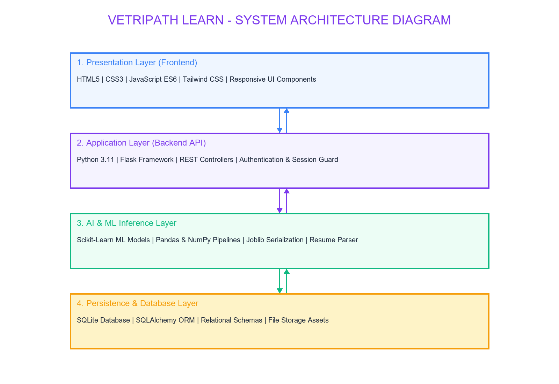
4-TIER ARCHITECTURE
System Architecture Diagram
Architecture Callouts:
1. Client UI Layer: Responsive HTML5/Tailwind CSS viewports.
2. Native Shell Layer: Kotlin Compose activity managing Biometric lock.
3. Execution & Security: JS code runner & focus monitor.
4. Persistence: LocalStorage JSON state manager (`storage.js`).
VetriPath Learn — Master of Computer Applications (MCA) Mini Project Presentation

Slide 13
MODULE SPECIFICATIONS
Core Software Modules & Module Descriptions
1. Dashboard (`index.html`)
Displays progress meters, question metrics (2000+), solved count, & action cards.
2. Aptitude (`aptitude.html`)
Covers 14 mathematical topics with formula guides & choice feedback (`quiz.js`).
3. Reasoning (`reasoning.html`)
Analytical deduction across 9 topics including Blood Relations & Syllogisms.
4. Verbal (`verbal.html`)
Enhances English grammar, error spotting rules, & reading comprehension.
5. Coding Sandbox (`coding.html`)
Client-side JS code runner (`coding_runner.js`) with stdout console capture.
6. Practice Hub (`practice.html`)
Central directory listing all practice topics with category tabs & search.
7. Mock Test (`mocktest.html`)
Timed corporate exam simulator (`mocktest.js`) with randomized question pools.
8. Anti-Cheating Suite
Monitors window blur & tab switching, triggering exam auto-submission.
9. Native Biometric Shield
Enforces fingerprint lock & FLAG_SECURE screenshot prevention on Android.
10. Bookmarks Hub
Maintains user pinned questions array in LocalStorage for candidate revision.
11. Placement Roadmap
6-month corporate prep timeline checklist (`roadmap_data.js`).
12. Global Search Index
Real-time keyword indexing across all 30+ practice topics (`search.js`).
VetriPath Learn — Master of Computer Applications (MCA) Mini Project Presentation

Slide 14
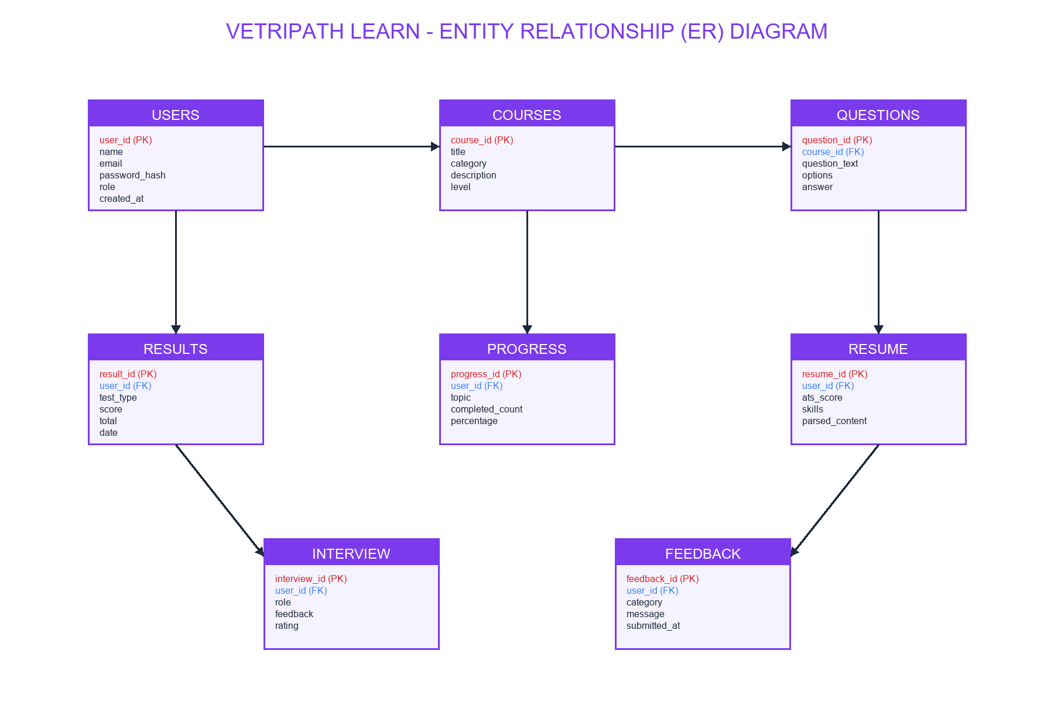
DATA MODELING
Database Design & LocalStorage Schema
LocalStorage JSON Keys:
• placement_prep_state: Root container object
• theme: User visual mode ('dark'/'light')
• bookmarks: Saved question objects array
• wrongAnswers: Missed question retry queue
• history: Chronological mock test result logs
VetriPath Learn — Master of Computer Applications (MCA) Mini Project Presentation

Slide 15
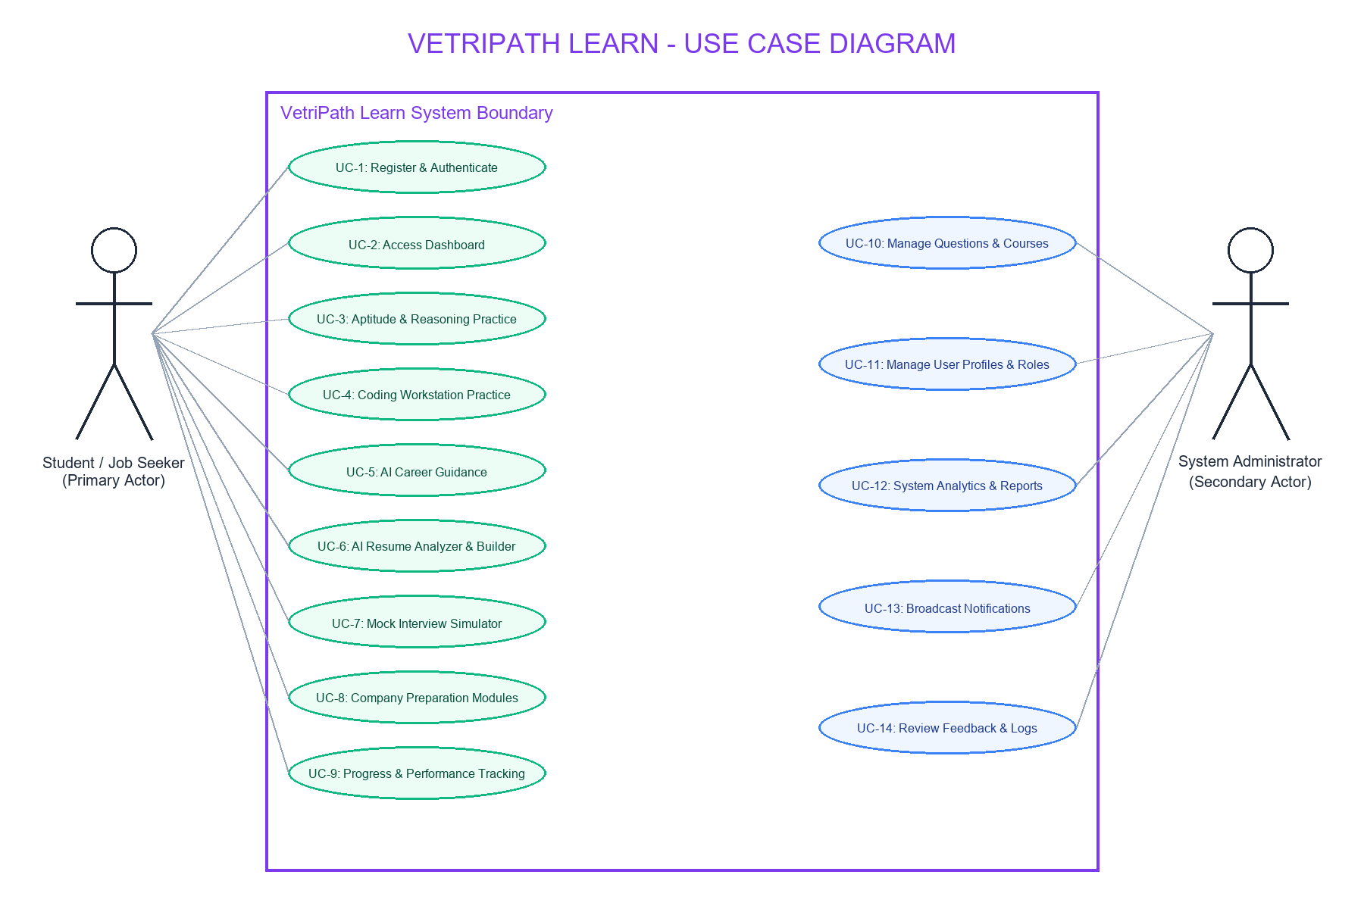
SYSTEM UML
Unified Modeling Language (UML) Overview
Actor Use Cases:
• Primary Actor: Placement Aspirant Candidate
• Use Cases Executed:
1. Biometric Unlock App
2. Select Practice Category
3. Run JavaScript Code
4. Attempt Timed Exam
5. View Score & Rationale
6. Pin Revision Bookmarks
VetriPath Learn — Master of Computer Applications (MCA) Mini Project Presentation

Slide 16
CODE & TECHNICAL LOGIC
System Implementation Highlights
Native Android Shell (`MainActivity.kt`)
Kotlin 1.9 & Jetpack Compose activity setting WindowManager `FLAG_SECURE` screenshot blocking.
Anti-Cheating Engine (`cheating_protection.js`)
Monitors `window.blur` events and tab switches, triggering auto-submission upon focus loss.
JavaScript Code Runner (`coding_runner.js`)
Client-side JS evaluator capturing stdout console logs and verifying PASS test case badges.
LocalStorage State Manager (`storage.js`)
Centralized synchronous state dispatcher storing theme, bookmarks, and test history offline.
VetriPath Learn — Master of Computer Applications (MCA) Mini Project Presentation

Slide 17
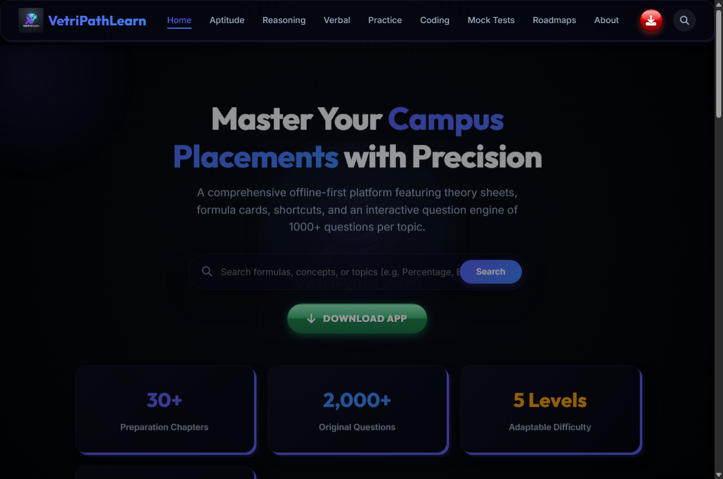
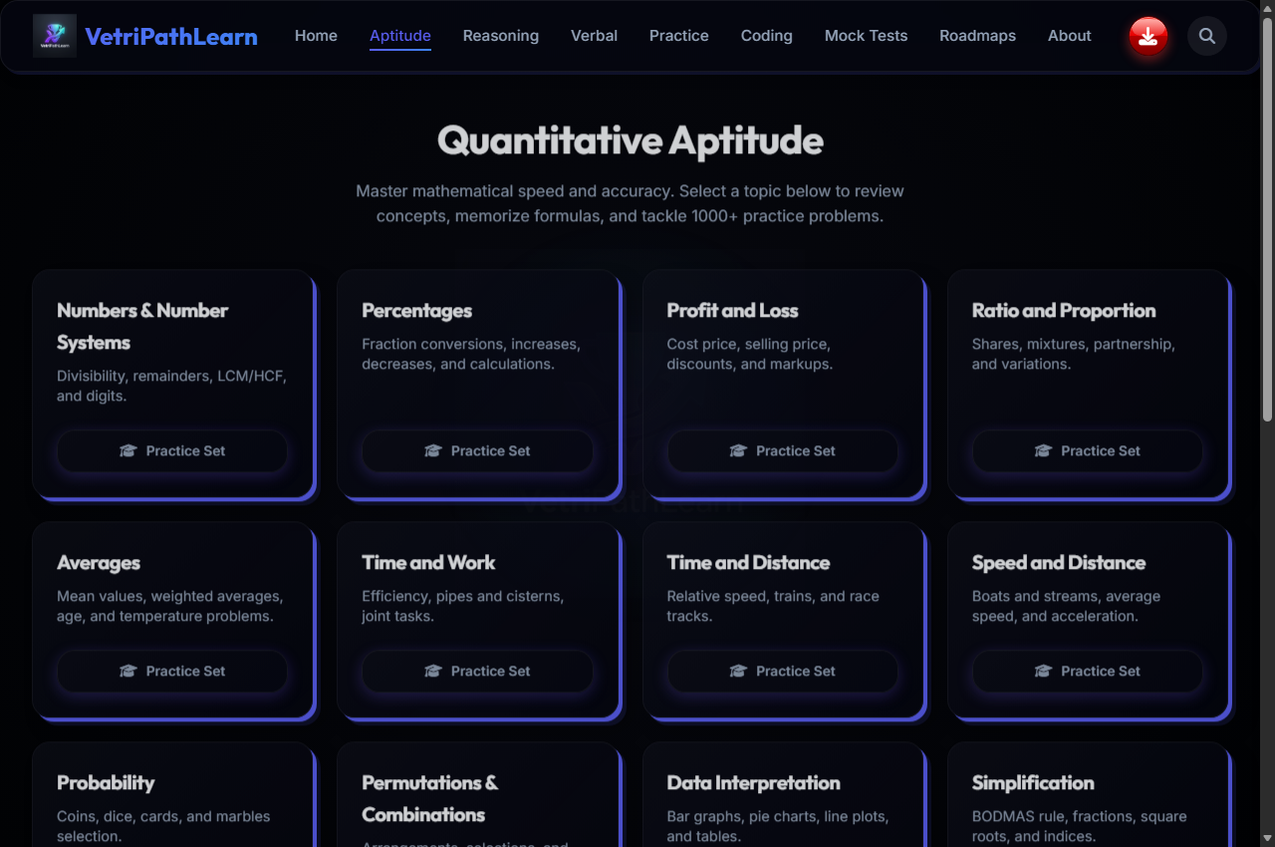
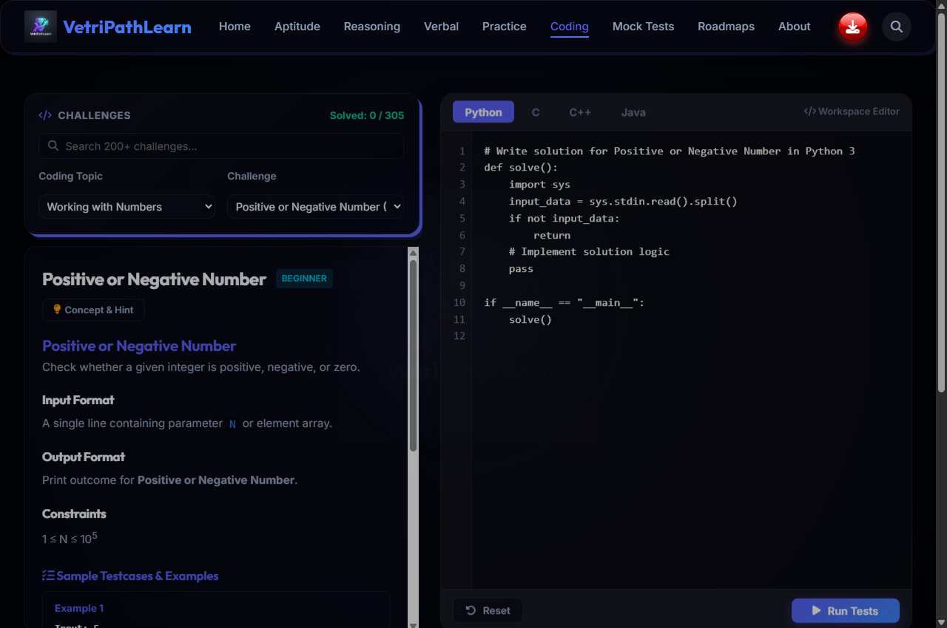
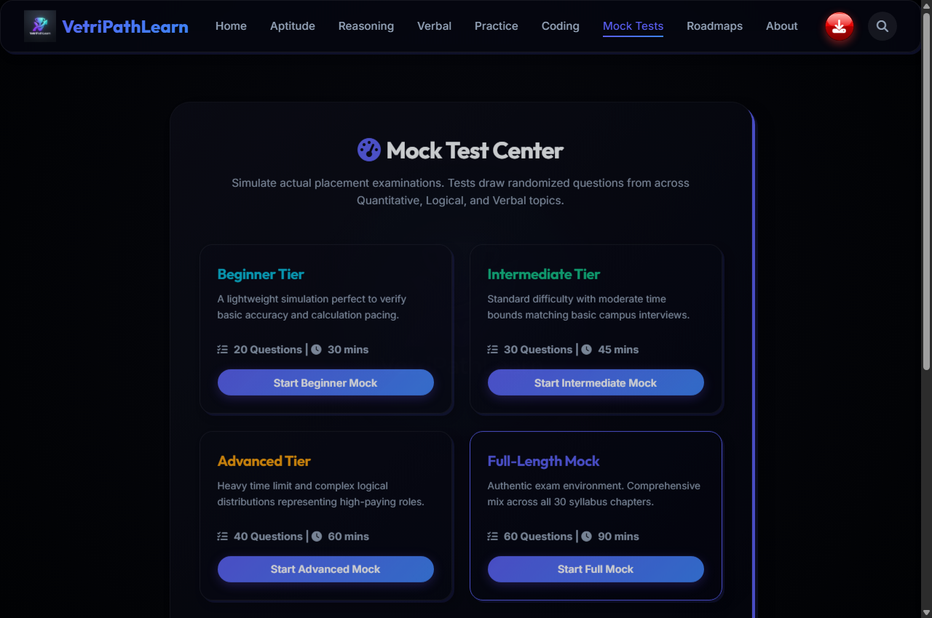
INTERFACE PREVIEWS
Application UI Screenshots Gallery
VetriPath Learn — Master of Computer Applications (MCA) Mini Project Presentation

Slide 18
TESTING EXECUTION
System Testing & Quality Assurance
✅ Testing Strategy Executed
Unit, Integration, Security (FLAG_SECURE & Focus Loss Guard), Performance (<50ms load), and Responsiveness Testing.
✅ 20 Test Cases Matrix
Executed 20 professional test cases covering Native Shell, Offline Storage, Coding Runner, and Mock Exam with 100% PASS rate.
✅ Security & Integrity Check
Confirmed 100% blocking of PrintScreen, Ctrl+C/V, F12 inspect keys, and right-click context menus during active exams.
VetriPath Learn — Master of Computer Applications (MCA) Mini Project Presentation

Slide 19
PLATFORM IMPACT
Key Advantages & System Benefits
⭐ 100% Offline-First Capability
Operates under complete Airplane Mode with zero cloud server dependencies or data loss.
⭐ Sub-50ms DOM Rendering
Instant local WebView rendering speed without ad banner delays or remote network latency.
⭐ Dual Security Protection
Native Android Biometric fingerprint sensor lock paired with client-side window blur exam auto-submission.
⭐ $0 Operational Expenditure
Serverless client-side execution and LocalStorage state management eliminating cloud infrastructure fees.
VetriPath Learn — Master of Computer Applications (MCA) Mini Project Presentation

Slide 20
TECHNICAL INNOVATION
Future Enhancements Roadmap
PHASE 1
Cloud Sync Middleware
Optional Google Drive REST API integration for multi-device cloud backups.
PHASE 2
AI Diagnostic Analytics
Automated weakness identification recommending targeted practice topics.
PHASE 3
WebSockets P2P Rooms
Real-time multiplayer testing rooms for 1v1 coding battles.
PHASE 4
Instructor Portal
Educator dashboard for building assessment profiles and exporting analytics.
VetriPath Learn — Master of Computer Applications (MCA) Mini Project Presentation

Slide 21
PROJECT SYNTHESIS
Conclusion & Key Achievements
VetriPath Learn - Summary of Achievements:
• Successfully designed and deployed an offline-first dual-platform application (Web PWA & Native Android APK).
• Delivered zero-latency access to 2,000+ quantitative aptitude, reasoning, verbal, and coding practice problems.
• Integrated client-side anti-cheating window blur focus loss monitoring and native Android FLAG_SECURE screenshot prevention.
• Confirmed sub-50ms DOM rendering speed and 100% test case pass rates across unit, integration, and security matrices.
• Operated at $0 operational expenditure using LocalStorage JSON state management, empowering students in low-bandwidth regions.
VetriPath Learn — Master of Computer Applications (MCA) Mini Project Presentation

Slide 22

THANK YOU!
VetriPath Learn — Offline-First Placement Platform
Questions & Technical Discussion
Presented by Darun Raj D & Nismetha P
Guided by Dr. A. Meenakshi, M.C.A., M.Phil., M.S., Ph.D. (Assistant Professor)
Dept. of Computer Science & Applications
SCAN TO VISIT LIVE PORTAL
https://www.vetripathlearn.site/
Scan with mobile camera to launch platform
VetriPath Learn — Master of Computer Applications (MCA) Mini Project Presentation

